Slide 1
Proposition 218 Assessments: An Option for Funding Maintenance and Capital Improvements for the Irish Beach Water System Matt Emrick Charlie Acker The Prop. 218 Committee August 6, 2022
Notes:
Ken Terry will welcome participants and explain that this is the first in a series of meetings to discuss various aspects of a Proposition 218 initiative.
He will explain that the workshop will cover a lot of information, but we will discuss these issues several times, so don’t worry if you don’t capture everything at this meeting – there will be plenty more opportunities in future.

Slide 2
Workshop Agenda
The Water District’s Needs
The Proposition 218 Process
The Proposed Projects
Discussion & Questions
The Schedule & Next Steps
Notes:
Ken Weston will explain that the meeting is made up of 3 segments:
The District’s General Counsel, Matt Emrick, and the Proposition 218 Committee will provide an overview of the Prop. 218 process.
The District’s General Manager, Charlie Acker, will share information about the water system facilities identified for maintenance and upgrade.
Ken will facilitate a discussion about the process and the projects among the community, the Board and District staff.
He will note that the presenters are going to try to move quickly through the first two parts of the meeting so that everyone has a basic understanding of the Proposition 218 process. Once we complete the presentation, there will be ample time to ask questions, offer observations, and express concerns, so we ask that you try to hold your questions until we get to the discussion segment of the agenda.
Any questions before we get started?

Slide 3
Irish Beach Water District Needs: Why Do We Need a Proposition 218 Assessment?
The purpose of an assessment is to ensure the long-term water supply reliability to the District.
Many of the District’s facilities are 40-50 years old and showing signs of wear / potential failure.
Notes:
Heather:
You may wonder why we are discussing a proposition 218 initiative when many of you already pay water usage charges and availability fees.
We’re talking about a Proposition 218 Assessment because we need a source of revenue that will allow the District to perform long overdue maintenance on some facilities, while upgrading others using modern materials, so that Irish Beach residents will continue to have access to safe, reliable water for many years to come.
As you can see from the list of a few examples, much of the distribution system, the pipelines that deliver water, are more than 50 years old and have long surpassed their useful life. District staff have noted signs of potential failure and we need to act before we are faced with emergency repairs and potential reduction in water capacity.

Slide 4
Irish Beach Water District Needs: Why Do We Need a Proposition 218 Assessment?
The prior assessment (2002 – 2016) funded upgrades for many of the District’s facilities. But maintenance and upgrades have been deferred for other critical parts of our water system.
The costs of maintenance, repair, and replacement have increased dramatically.
The existing water source, storage, and distribution system will not support full build-out.
An assessment spreads the cost of maintenance and improvements over many years and stabilizes funding resources so that the community will not be faced with recurring availability fee increases.
Notes:
Heather:
The District last imposed assessments in 2016, which provided funds to complete critical improvements, such as the replacements of Tank 1 and Tank 3 with modern bolted steel storage facilities.
Moreover, in FY 2021/2022 the District raised availability fees to build a reserve to cover the cost of additional improvements, and obtained grant funding to cover much of the cost of renovating Tank 2 and Tank 5 as well as activating Well 2.
However, the list of deferred maintenance projects and the need for improvements to critical water system infrastructure is substantial. We must have a source of revenue that will allow the District to implement a long-term plan to repair and upgrade facilities beyond those that have been covered by State grants.
And due in part to regulatory changes, the water system must be expanded to support connections for all 459 parcels, which will require significant investment over the course of many years.
A prop. 218 assessment will provide the means for the District to implement a capital improvement plan to ensure the ongoing viability of our water system and spreads the costs over many years.

Slide 5
Why Not Raise Rates & Availability Fees for Parcels Connected to the Water System?
District Fees & Charges:
Usage Fees – transmission and distribution costs
Connection Fees – costs to connect to the water system (presently)
Availability Charges - operating costs and water source development
Assessments – new projects and improvements to existing facilities
Notes:
Matt

Slide 6
How Does the Proposition 218 Process Work?
Overview:
“Right to vote on taxes” Act approved by California voters in November 1996.
Certain water-related charges cannot be increased without:
Written Notice to rate payers; and
An opportunity for Landowners to protest the increase.
Notes:
Matt

Slide 7
How Does the Proposition 218 Process Work?
Overview Continued:
Does not apply to District Usage and Connection fees.
Does apply to Assessments and Availability charges
Notes:
Matt

Slide 8
How Does the Proposition 218 Process Work?
Availability Charges = Majority Protest Procedure (connected users only)
District schedules a public hearing not less than 45 days following the mailing of notices to Landowners in the District.
Landowners have until the close of the public hearing to submit a signed written protest of the rate increase.
The District cannot raise the availability charge If 51% of the properties in submit written protects.
Notes:
Matt

Slide 9
How Does the Proposition 218 Process Work?
Assessments = The Ballot Process
The District provides at least a 45-day written notice of a public hearing on the proposed assessment along with “ballots.”
At the noticed public hearing, the District tallies the Ballots.
If a majority of the ballots do not oppose the assessments, the District may vote to levy the assessment.
Notes:
Matt

Slide 10
How Does the Proposition 218 Process Work?
Special Benefits:
Only parcels identified as receiving a special benefit in the Engineer’s Report from a particular proposed project can be assessed.
A “special benefit” is “a particular and distinct benefit over and above general benefits conferred on real property located in the district or to the public at large.
General benefits are not assessed.
Notes:
Matt

Slide 11
The Assessment: The Engineering Study
Determine the Special Benefits to Each Parcel
Identify the parcels subject to the charge – special benefits that accrue only to parcels within IBWD.
Identify Maintenance & Improvement Projects
Identify short, mid, and long-term projects & calculate the total assessment revenue required annually.
Conduct Proportional Analysis
Determine the relative special benefits to each parcel and the amount of charge to be imposed to each.
Notes:
Brad:
As Matt explained, the District will need to take several steps before we’re ready to ask the community to vote on a Proposition 218 initiative:
In the coming months, we will solicit bids from engineering firms to complete an engineering study for special benefit assessments.
The selected engineer will:
Research parcel attributes, parcel ownership information, and determine the special benefits conferred to each parcel.
Analyze the District’s facilities, and make recommendations for prioritizing maintenance projects, as well as capital improvement projects.
Review cost estimates and calculate the amount of revenue necessary on an annual basis.
Conduct a proportional analysis and make recommendations for apportioning annual assessments among parcels.

Slide 12
The Engineering Study – Examples of Special Benefits
Benefit of the District’s Existence – the value of the District’s operations and ability to secure and deliver water supplies
Benefit of the District’s Surface and Ground Water Supplies – preservation and protection of entitlement to water
Benefit of Fire Protection – fire safety improvements such as hydrants and proximity of Redwood Coast Fire Protection District equipment housed in IBWD property
Notes:
Brad:
The Proposition 218 committee reviewed the engineering reports prepared for other Special Districts in California and identified the types of special benefits that an engineer might identify when studying the Irish Beach Water District.
The fact that the District was formed, has the operational facilities and staff to deliver quality water supplies to parcels within the District boundaries is a benefit that is not available to properties not included in the IBWD.
The current drought has made it abundantly clear that safe and reliable water supplies are incredibly important. Without water, parcels in Irish Beach would have limited value. Our coastal neighbors to the North have provided a dramatic example of the importance of preserving entitlement to surface and ground water supplies and investing in the infrastructure to maintain a reliable system.
Finally, properties in Irish Beach benefit from the fire protection systems incorporated into the water system. The fact that Irish Beach has hydrants, as well as distribution systems to move water from one part of the District to another in case of emergency, provides a greater level of protection, which is reflected in our ISO rating.

Slide 13
The Engineering Study: Identify Maintenance & Improvement Projects (short-term (0-5 yrs.), mid-term (6-15 yrs.), & long-term (16-20 yrs.):
Maintaining current facilities is necessary for those currently connected to the water system, while new sources of water supply and additional storage is necessary for future connections.
Degrading distribution systems are a point of focus. Modern metering technology has helped to eliminate most leaks at individual parcels, but IBWD pipelines are in poor condition.
Increasing storage is a top priority and invaluable to maintaining a viable water supply during periods of drought.
Adding water sources through new wells is also a key component of the plan.
Notes:
Charlie:
Will describe the projects that District staff have identified as critical to maintaining the reliability of the water system.
He will explain the signs of wear and end of useful life exhibited by various facilities and provided images to illustrate the rationale for including each project in the maintenance and capital improvement plan.
Moreover, he will describe the projects that will be necessary to support expansion of the system to accommodate increased development and additional connections to the water system.
Finally, he will explain that this is the first draft of the preliminary project list, which will be refined as we work with the engineer.

Slide 14
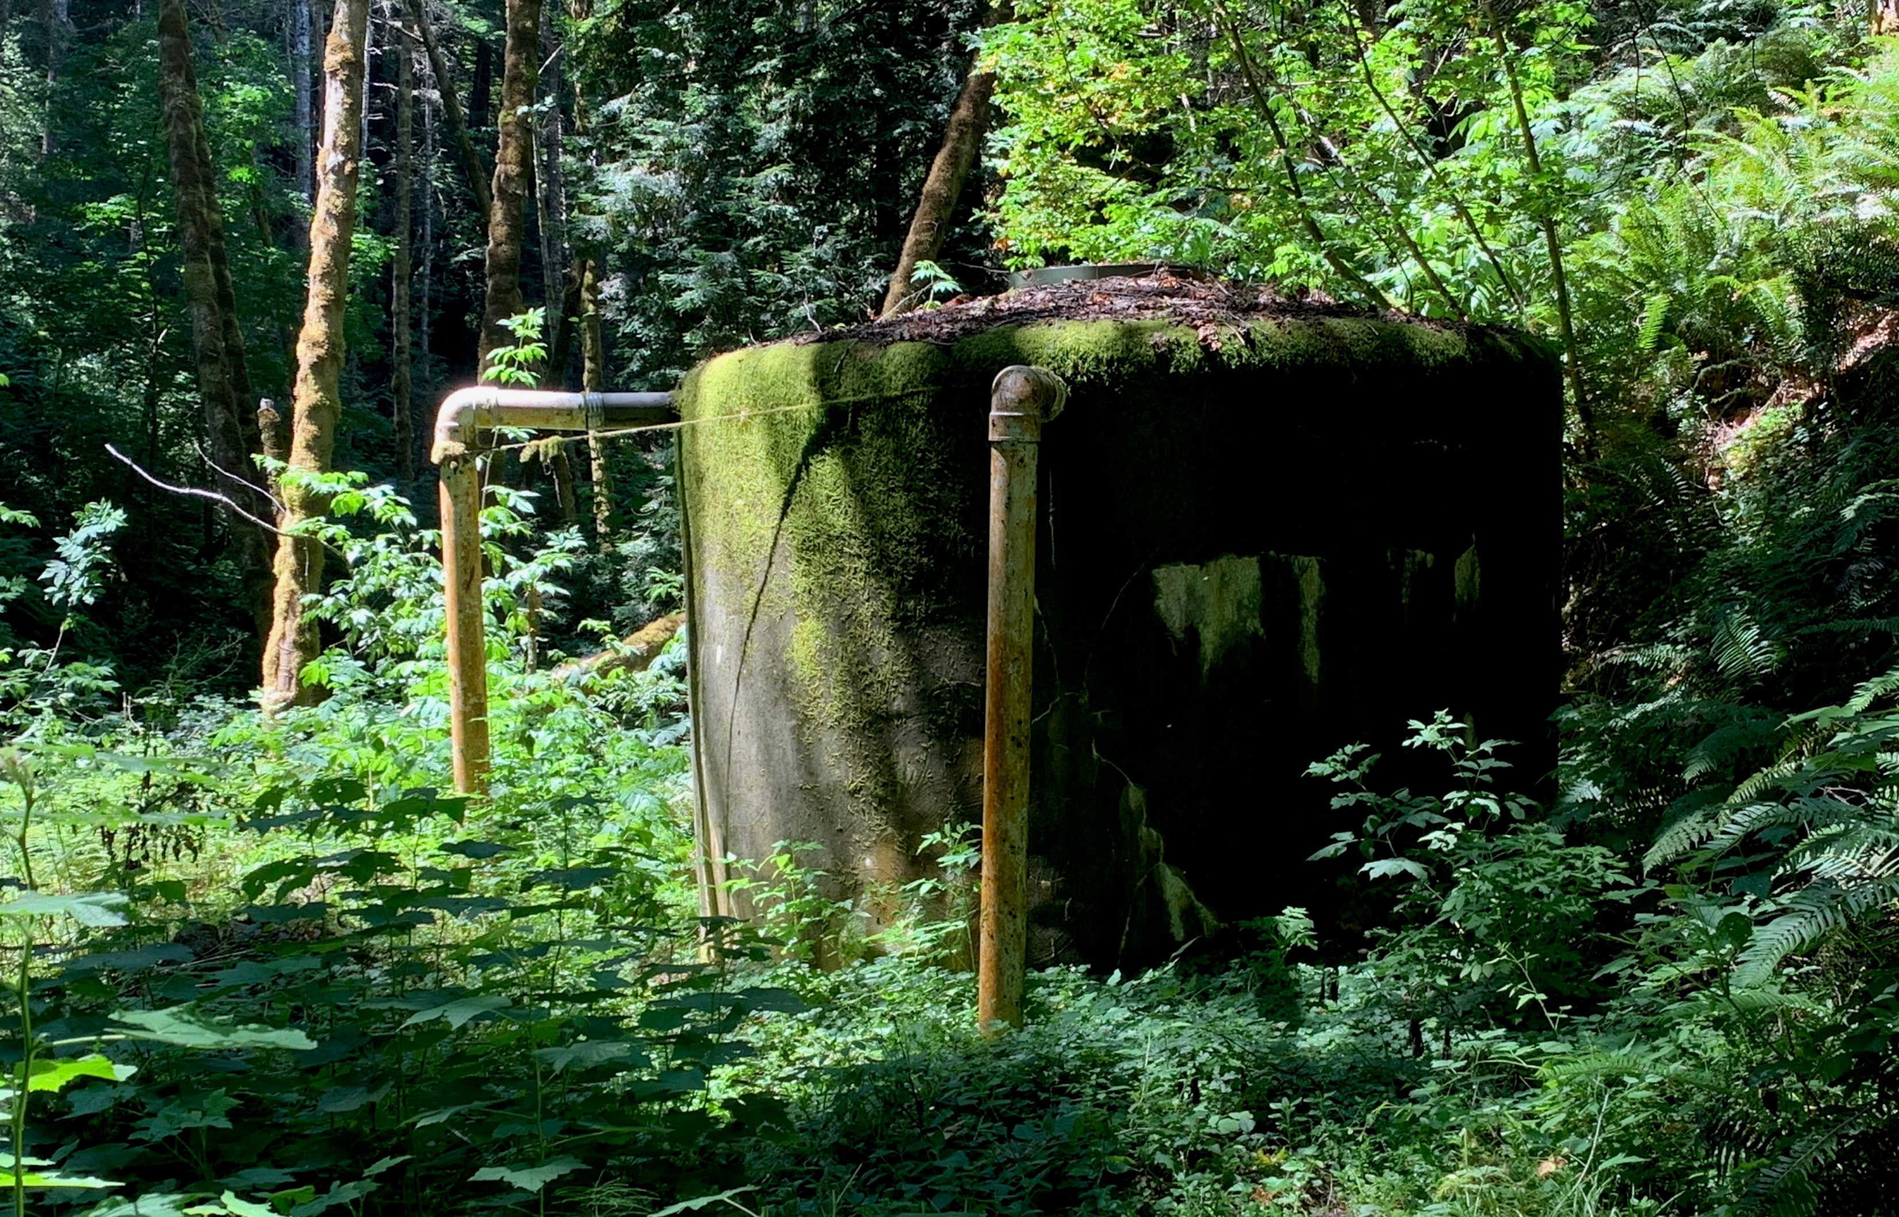
Short-term Projects (0-5 years)
Circa 2010 - Tank 3: 80,000 Gallon Bolted Steel on Concrete. Recoat steel tank with special 2-part paint. Exterior showing areas of coating damage.
Circa 1983 - Tank 0: 10,000 Gallon Concrete Tank. Replace 10,000-gallon ferro cement tank has numerous cracks and the roof has limited strength.
Notes:
Charlie:
Will describe the projects that District staff have identified as most critical, which will be completed in the short term if the Proposition 218 initiative is approved.

Slide 15
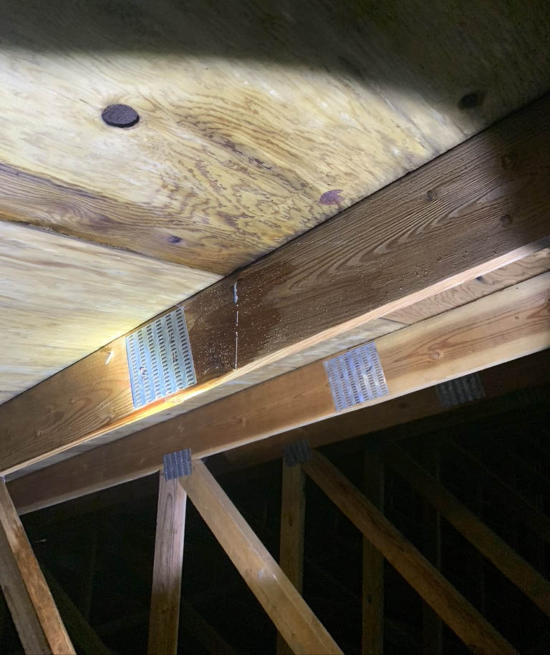
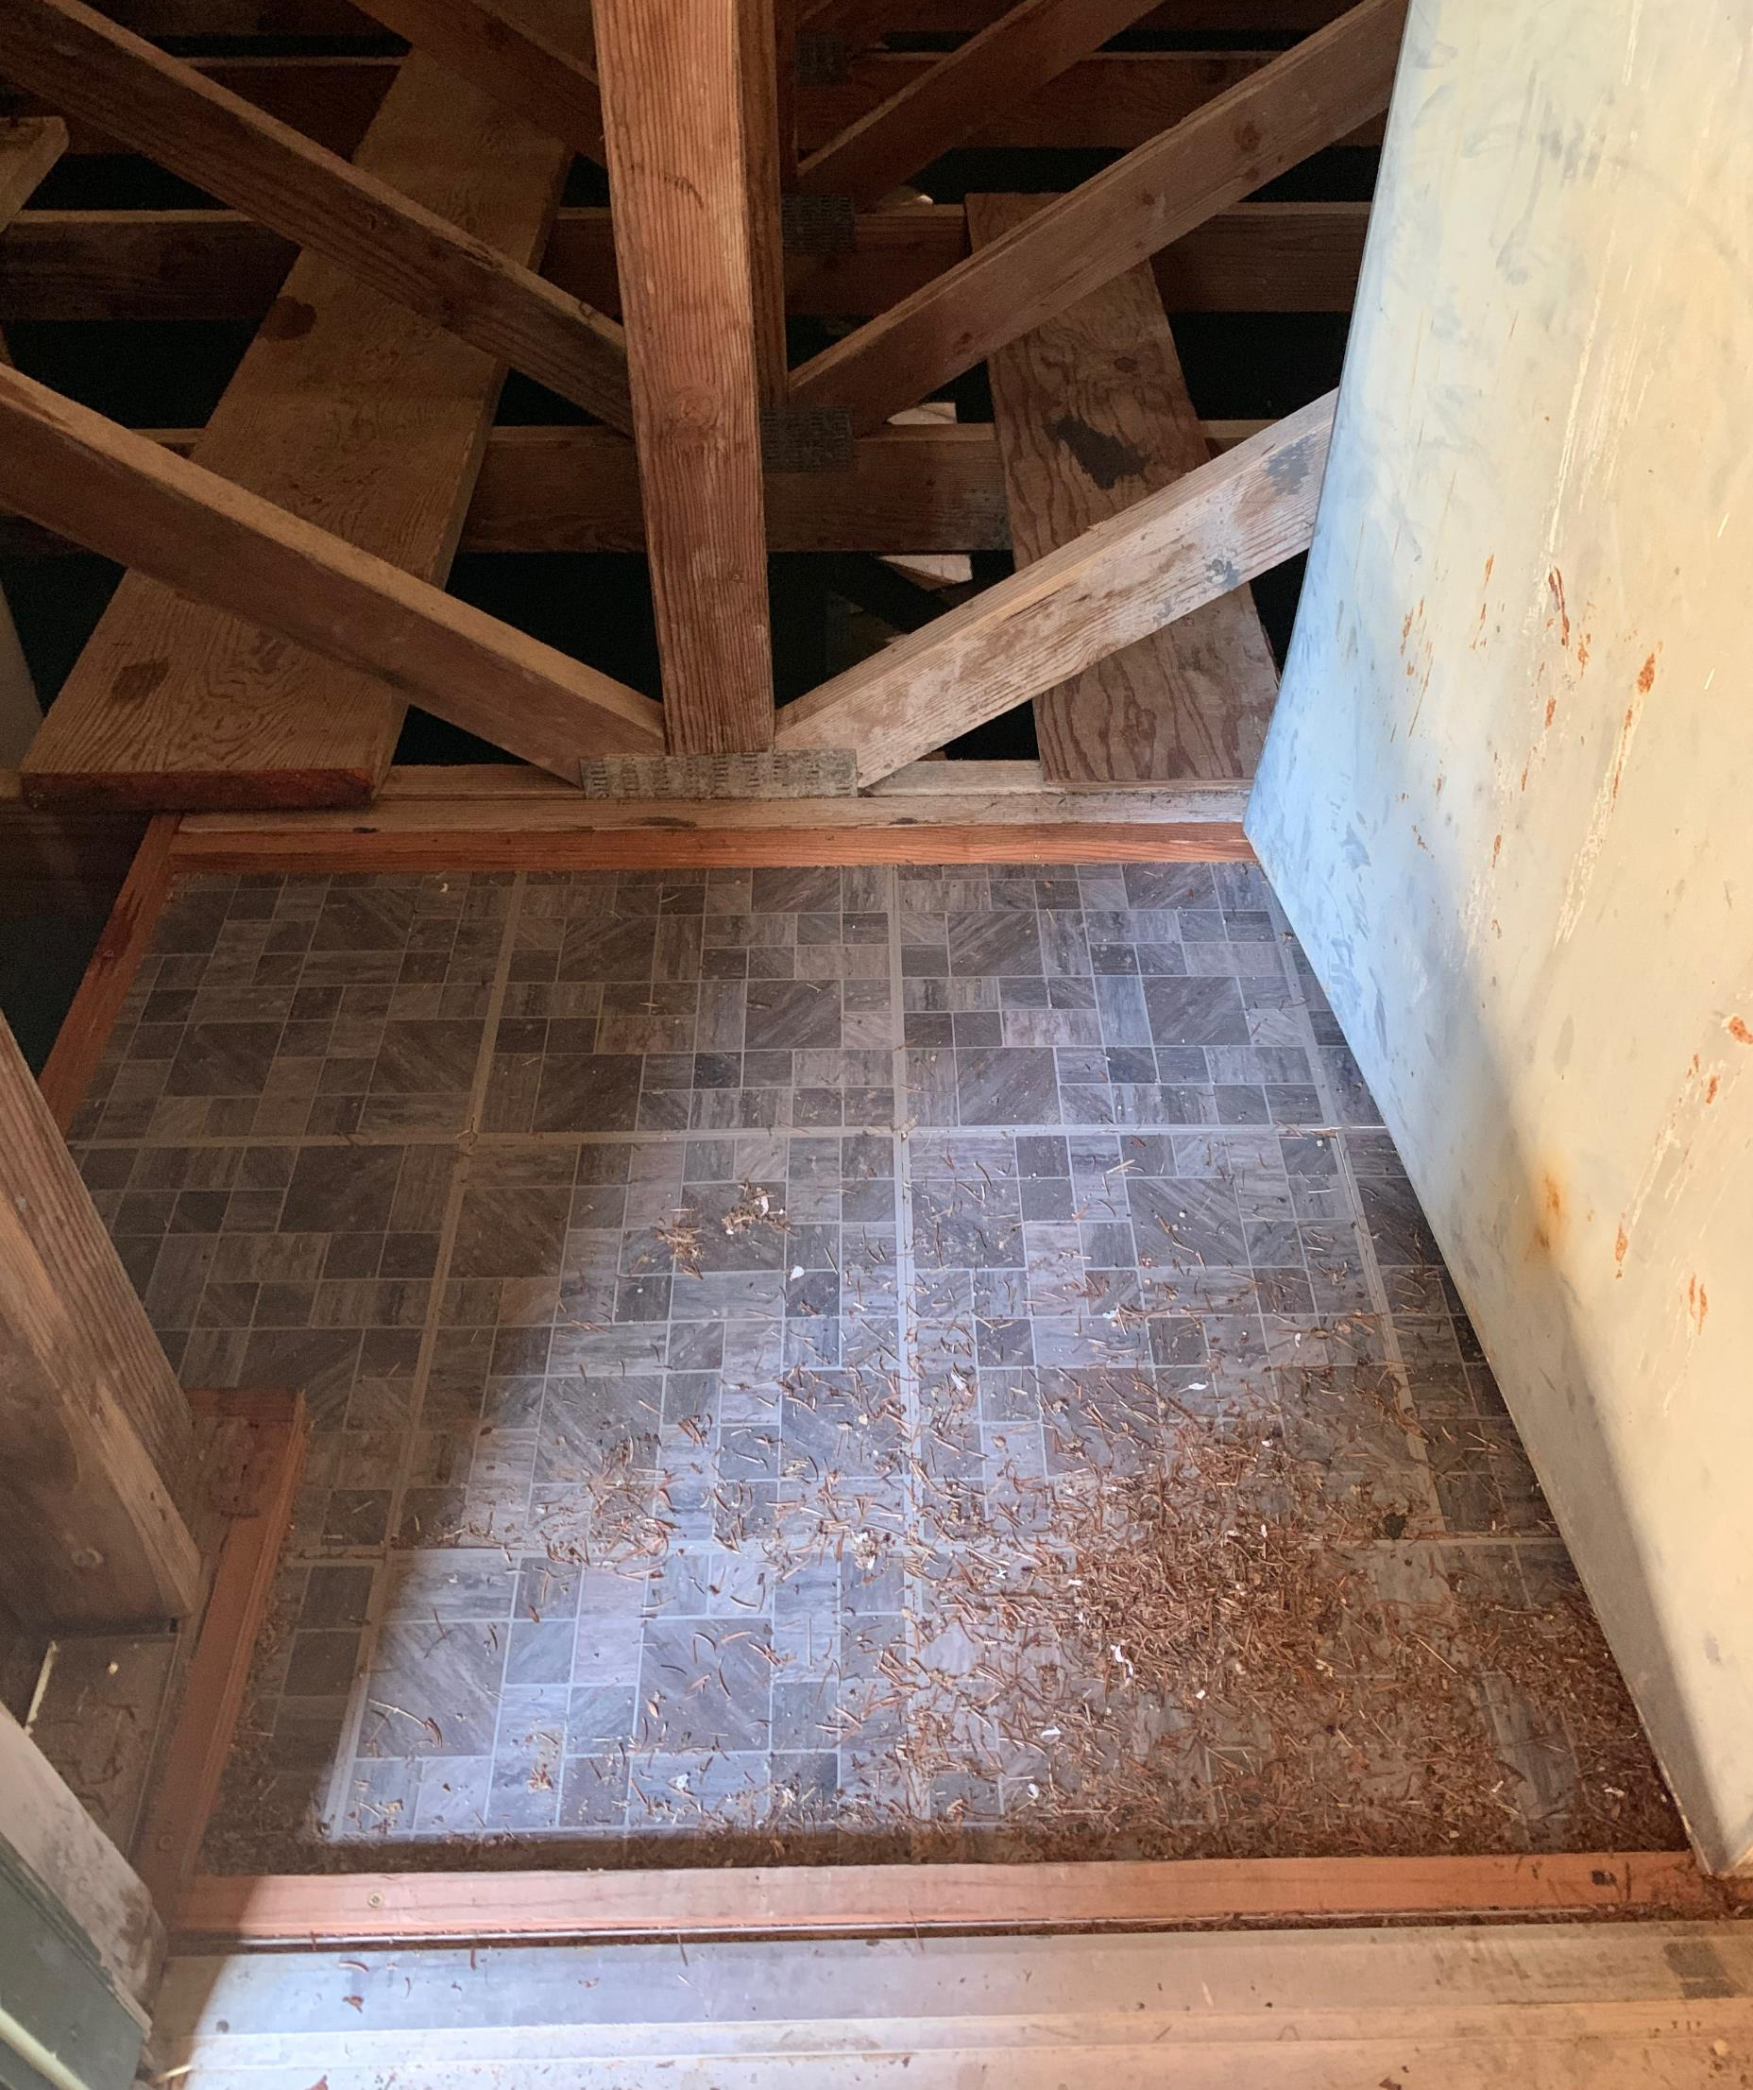
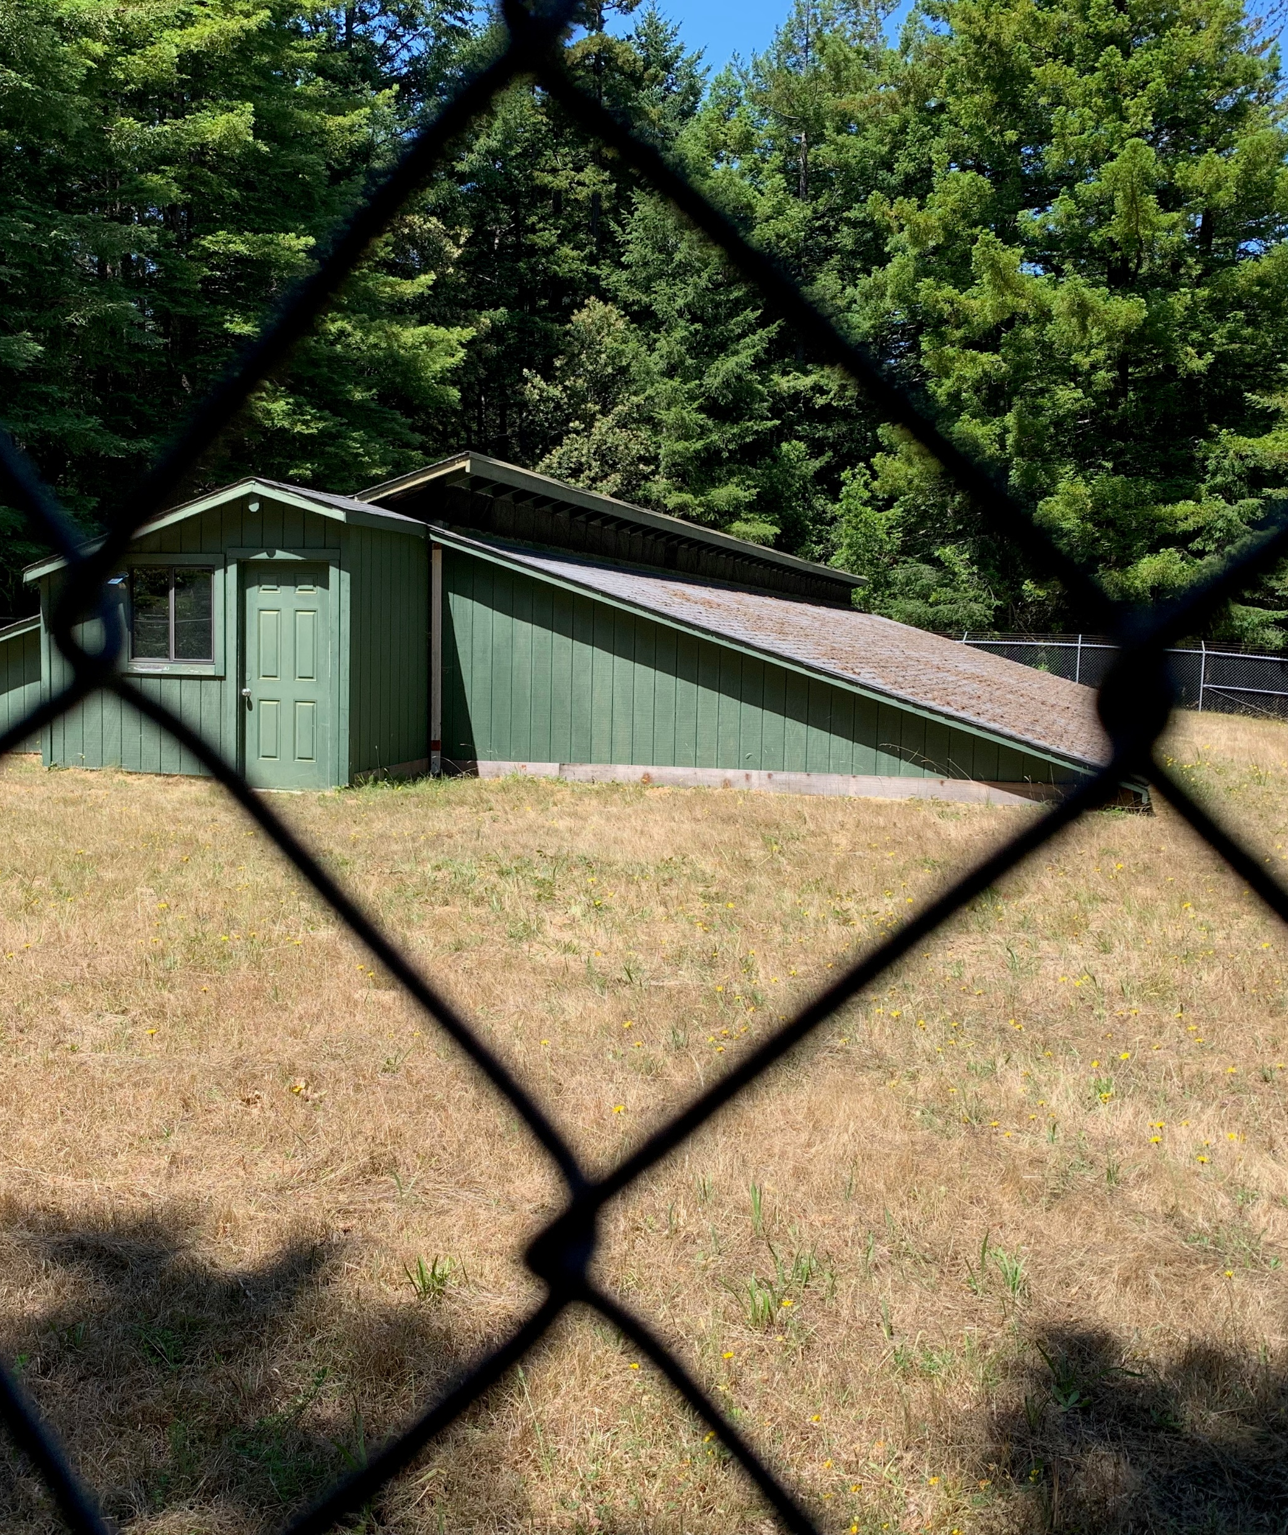
Mid-term Projects (6-15 years)
Circa 1985 - Water Treatment Plant Filters & Equipment: Replaced failing parts as urgent repairs needed. Entire water plant filter assembly is showing age and needs replacement.
Circa 1989 - Tank 4: 125,000-gallon concrete tank: The roof and siding of the wooden truss structure covering the tank is deteriorating and has a termite & carpenter ant infestation.
Notes:
Charlie:
Will describe the projects that District staff have identified as important, but lower priority than the short-term projects. These will be completed in the mid-term if the Proposition 218 initiative is approved.

Slide 16
Mid-term Projects (6-15 years)
Circa 1978 - 6" PVC Pipeline in Unit 7 and Unit 5: 820 linear feet (Hunolt to Pomo Lake Dr.) and 370 linear feet (Unit 5 to Hunolt) have numerous leaks and power lines touching the water main.
Circa 1989 - 3" PVC Pipeline in Unit 9: 1,200 linear feet (Lot 3 to Tank T3) is leaking.
Notes:
Charlie:
Will describe the projects that District staff have identified as important, but lower priority than the short-term projects. These will be completed in the mid-term if the Proposition 218 initiative is approved.

Slide 17
Mid-term Projects (6-15 years)
Circa 1967 - 4" asbestos pipeline in Unit 3: 1,347 linear feet (Cypress Parkway Loop) has a history of blow-outs.
Circa 1978 - 3" PVC Pipeline in Unit 7: 670 Linear feet (Pomo Lake Dr. sub-feed from O’Rorey's Tee to Pump Station A) has numerous leaks.
Notes:
Charlie:
Will describe the projects that District staff have identified as important, but lower priority than the short-term projects. These will be completed in the mid-term if the Proposition 218 initiative is approved.

Slide 18
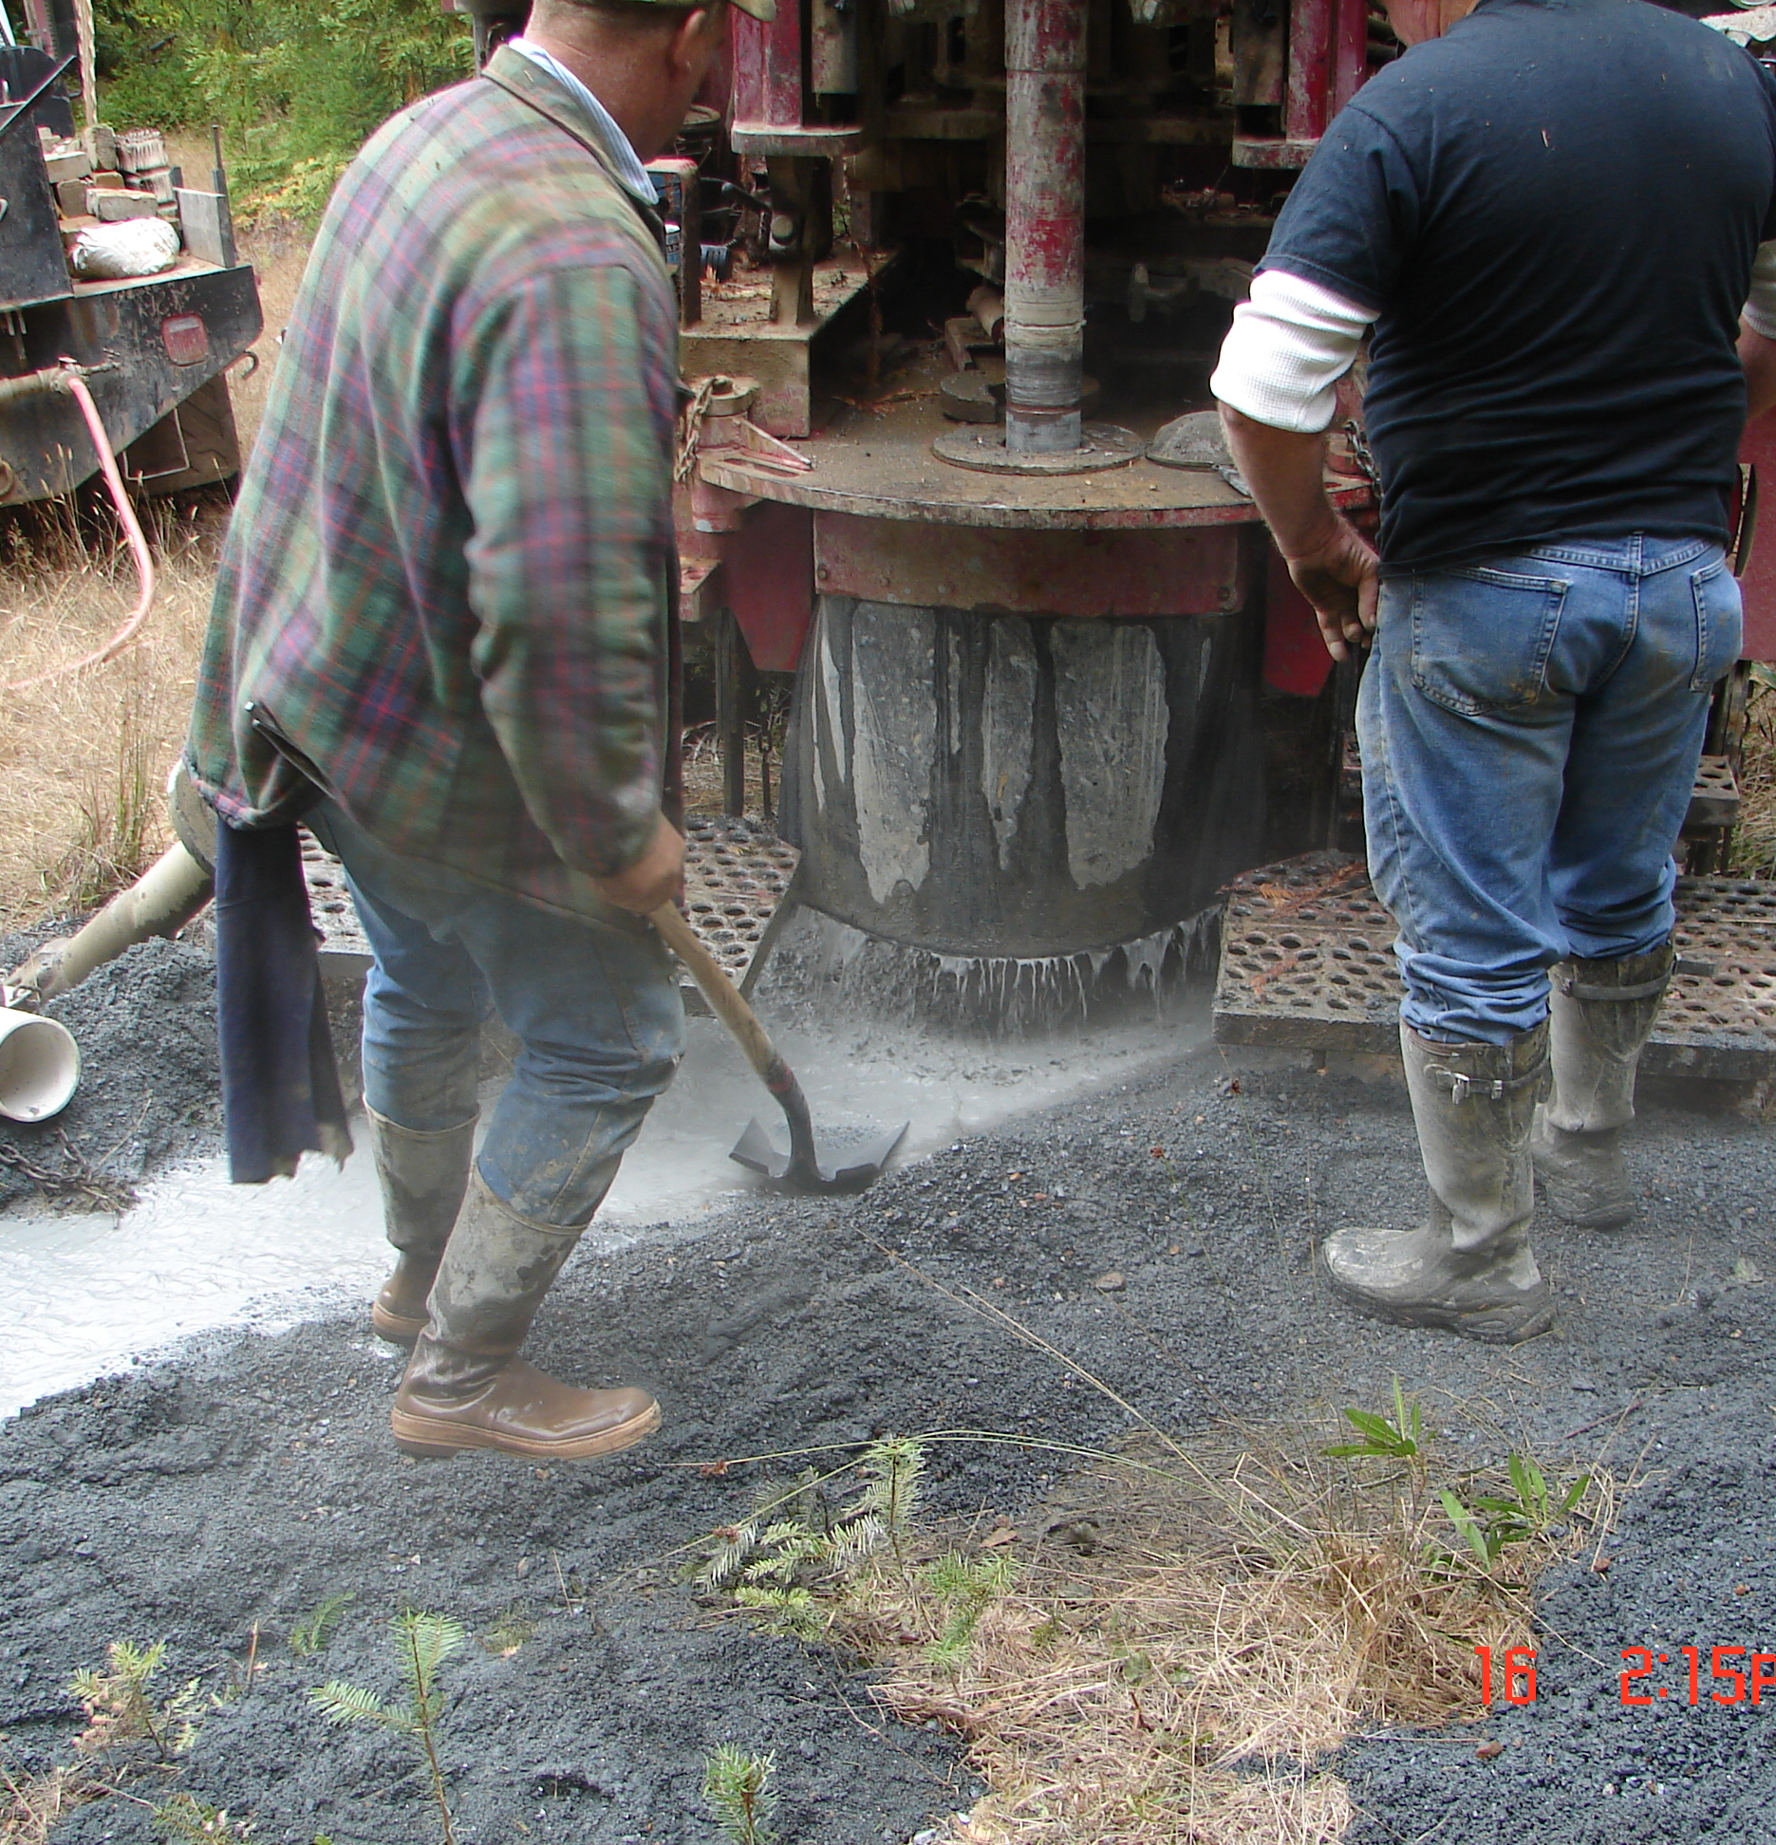
Long-term Projects (16-20 years)
Circa 1989 - 6" asbestos pipeline in Unit 9: 1,165 linear feet (Alta Mesa to Pump Station B) and 600 linear feet (along Sea Cypress).
New Well: Wellhead, electrical, controls and pipeline to expand system capacity in support full build-out.
New Tank: Bolted steel tank to expand system capacity in support of full build-out.
Notes:
Charlie:
Will describe the projects that District staff have identified as necessary in the long term, including those that will be necessary to support expansion of the system to accommodate increased development and additional connections to the water system.

Slide 19
The Engineering Study – Examples of Proportional Analysis
Flat Rate Assessment – used when all parcels share equally in the special benefits conferred by the planned projects.
Assessed Value Apportionment – used when parcels with higher assessed value are conferred a greater special benefit than those will lower assessed values.
Single Family Equivalent Ratios – used when both developed and undeveloped parcels derive special benefit, but undeveloped parcels are differences in the degree of benefit.
Notes:
Judy:
As Matt and Brad explained, one of the steps that the engineer will take is to review cost estimates for the proposed projects and calculate the amount of annual revenue needed to complete the planned projects.
Next, the engineer will consider options for apportioning annual assessments among parcels. There are numerous options for the engineer to consider, and we don’t know which will be recommended, but I’m going to mention 3:
A flat rate assessment might be applied if the engineer determines that all parcels share equally in the special benefits conferred by the proposed projects, in which case the annual revenue need is divided by the total number of parcels, so that each parcel pays the same assessment amount.
Another option is to apportion costs based on assessed value. This method first determines the total assessed value of all parcels (both developed and undeveloped) and establishes an assessment rate for each parcel based on the ratio of individual parcel assessed value to total assessed value of all parcels. Using this method, parcels with higher assessed value, pay a larger assessment.
Finally, a Single Family Equivalent calculation is often used when both developed and undeveloped parcels derive special benefit. The benefit to undeveloped parcels is determined to be proportional to the corresponding benefits for similar developed parcels, but at a lower rate due to the lack of improvements. A measure of the benefits accruing to the underlying land is the average value of land in relation to improvements for developed property.

Slide 20
Questions & Community Discussion
What is appealing to you about the Proposition 218 process and planned projects?
What worries you about the Proposition 218 process and planned projects?
What else would you like to know about the Proposition 218 process and plans?
Notes:
Ken Weston will explain that we have reached the point in the meeting where we would like to hear from the community.
The idea is to share observations, ask questions, and voice concerns in a neighborly fashion.
We may not be able to address all of the issues today; however, we will take note of all viewpoints, and the District will do it’s best to address the issues.
Who would like to start?

Slide 21
What’s Next?
Request for Proposals: Engineering Study
September 26, 2022
Award Contract for Engineering Study
November 12, 2022
Second Interactive Workshop
April 15, 2023
Approve Final Engineering Report
May 13, 2023
Prop 218 Ballots Mailed
May 22, 2023
Public Hearing
July 8, 2023
If Approved, the Assessment Begins
January 2024
Notes:
Heather will summarize next steps and encourage participants to mark their calendars for the 9/17/22 Board meeting, where we will review the draft RFP.

Slide 22
Thank you for taking the time to participate in the workshop & discussion.
Notes:
Ken Terry will close the meeting, thank all participants, and give a special thank you to Ken Weston for facilitating the discussion.

